Slide 1
AI Planning
Introduction to Artificial Intelligence
CSCE476/876, Fall 2017:
www.cse.unl.edu/~choueiry/F17-476-876/
Send questions to Piazza
Berthe Y. Choueiry (Shu-we-ri)
Avery Hall, Room 360

Slide 2
Reading
Required reading
  Chapter 10
Recommended reading
  Chapter 11

Slide 3
Outline
Background
  Situation Calculus
  Frame, qualification, & ramification problems
Representation language
Algorithms

Slide 4
Background
Focus
  The focus here is deterministic planning
    Environment is fully observable
    Results of actions is deterministic
  Relaxing the above requires dealing with uncertainty
    Problem types: sensorless, contingency, exploration
Planning ‘communities’ in AI
  Logic-based: Reasoning About Actions & Change
  Less formal representations: Classical AI Planning
  Uncertainty (UAI): Graphical Models such as
    Markov Decision Processes (MDP), Partially Observable MDPs, etc.
AI Planning is not MRP (Material Requirements Planning)

Slide 5
Actions, events, and change
Planning requires a representation of time
  to express & reason about sequences of actions
  to express the effects of actions on the world
Propositional Logic
  does not offer a representation for time
  Each action description needs to be repeated for each step
Situation Calculus (AIMA Section 10.4.2)
  Is based on FOL
  Each time step is a ‘situation’
  Allows to represent plans and reason about actions & change

Slide 6
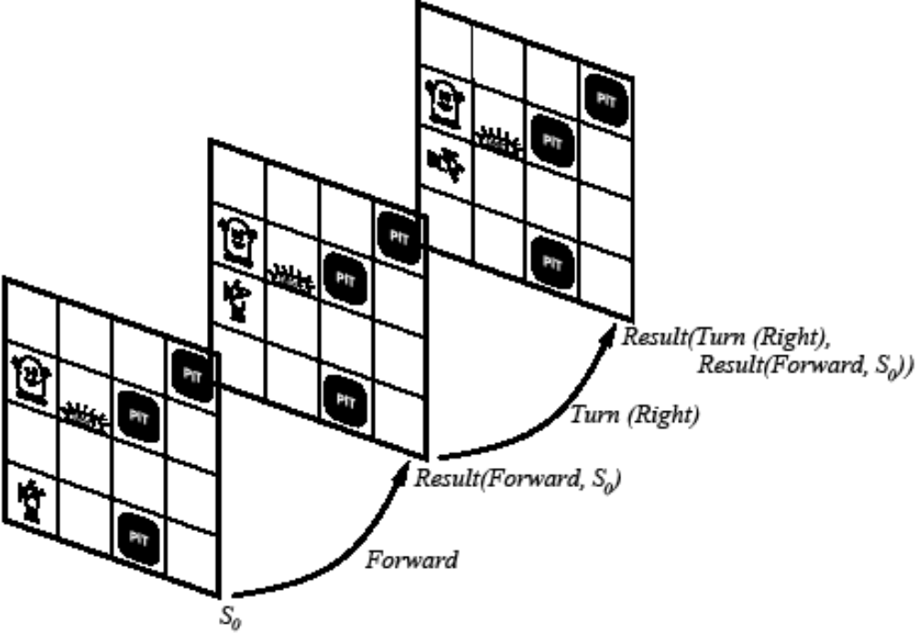
Situation Calculus: Ontology
Situations
Fluents
Atemporal (or eternal) predicates & functions
AIMA Section 10.4.2

Slide 7
Situation Calculus: Ontology
Situations
  Initial state: S₀
  A function Result(a,s) gives the situation resulting from applying action a in situation s
Fluents
  Functions & predicates whose truth values can change from one situation to the other
  Example: ¬Holding(G₁,S₀)
Atemporal (or eternal) predicates and functions
  Example: Gold(G₁), LeftLegOf(Wumpus)

Slide 8
Situation Calculus
Sequence of actions
  Result([],s)=s
  Result([a | seq],s)=Result(seq,Result(a,s))
Projection task
  Deducing the outcome of a sequence of actions
Planning task
  Find a sequence of actions that achieves a desired effect

Slide 9
Example: Wumpus World
Fluents
  At(o,p,s), Holding(o,s)
Agent is in [1,1], gold is in [1,2]
  At(Agent,[1,1],S₀) ∧ At(G₁,[1,2],S₀)
In S₀, we also need to have:
  At(o,x,S₀) ⇔ [(o=Agent) ∧ x=[1,1]] ∨ [(o=G₁) ∧ x=[1,2]]
  ¬Holding(o,S₀)
  Gold(G₁) ∧ Adjacent([1,1],[1,2]) ∧ Adjacent([1,2],[1,1])
The query is:
  ∃ seq At(G₁,[1,1],Result(seq,S₀))
The answer is
  At(G1,[1,1],Result(Go([1,1],[1,2]),Grab(G₁),Go([1,2],[1,1]),S₀))

Slide 10
Importance of Situation Calculus
Historical note
  Situation Calculus was the first attempt to formalizing planning in FOL
  Other formalisms include Event Calculus
  The area of using logic for planning is informally called in the literature “Reasoning About Action & Change”
Highlighted three important problems
  Frame problem
  Qualification problem
  Ramification problem

Slide 11
‘Famous’ Problems
Frame problem
  Representing all things that stay the same from one situation to the next
  Inferential and representational
Qualification problem
  Defining the circumstances under which an action is guaranteed to work
  Example: what if the gold is slippery or nailed down, etc.
Ramification problem
  Proliferation of implicit consequences of actions as actions may have secondary consequences
  Examples: How about the dust on the gold?

Slide 12
Outline
Background
  Situation Calculus
  Frame, qualification, & ramification problems
Representation language
Algorithms

Slide 13
Planning Languages
Languages must represent..
  States
  Goals
  Actions
Languages must be
  Expressive for ease of representation
  Flexible for manipulation by algorithms

Slide 14
State Representation
A state is represented with a conjunction of positive literals
Using
  Logical Propositions: Poor ∧ Unknown
  FOL literals: At(Plane1,OMA) ∧ At(Plan2,JFK)
FOL literals must be ground & function-free
  Not allowed: At(x,y) or At(Father(Fred),Sydney)
Closed World Assumption
  What is not stated are assumed false

Slide 15
Goal Representation
Goal is a partially specified state
A proposition satisfies a goal if it contains all the atoms of the goal and possibly others..
  Example: Rich ∧ Famous ∧ Miserable satisfies the goal Rich ∧ Famous

Slide 16
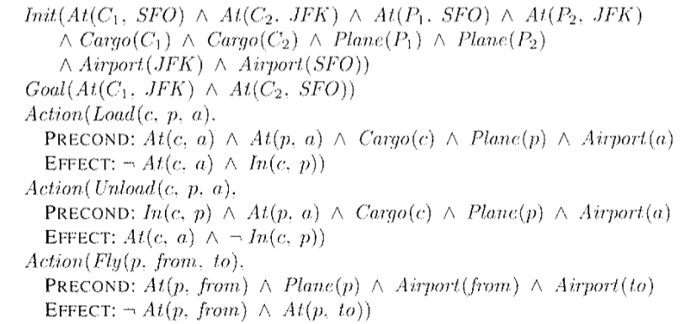
Example: Air Cargo
Initial state; Goal State; Actions: Load, Unload, Fly

Slide 17
Action Representation
Action Schema
  Action name
  Preconditions
  Effects
Example
  Action(Fly(p,from,to),
  Precond: At(p,from) ∧ Plane(p) ∧ Airport(from) ∧ Airport(to)
  Effect: ¬At(p,from) ∧ At(p,to))
Sometimes, Effects are split into Add list and Delete list
At(WHI,LNK),Plane(WHI), Airport(LNK), Airport(OHA)
Fly(WHI,LNK,OHA)
At(WHI,OHA), ¬ At(WHI,LNK)

Slide 18
Applying an Action
Find a substitution list θ for the variables
  of all the precondition literals
  with (a subset of) the literals in the current state description
Apply the substitution to the propositions in the effect list
Add the result to the current state description to generate the new state
Example:
  Current state: At(P1,JFK) ∧ At(P2,SFO) ∧ Plane(P1) ∧ Plane(P2) ∧ Airport(JFK) ∧ Airport(SFO)
  It satisfies the precondition with θ={p/P1,from/JFK, to/SFO)
  Thus the action Fly(P1,JFK,SFO) is applicable
  The new current state is: At(P1,SFO) ∧ At(P2,SFO) ∧ Plane(P1) ∧ Plane(P2) ∧ Airport(JFK) ∧ Airport(SFO)

Slide 19
Languages for Planning Problems
STRIPS
  Stanford Research Institute Problem Solver
  Historically important
ADL
  Action Description Languages
  See Table 11.1 for STRIPS versus ADL
PDDL
  Planning Domain Definition Language
  Revised & enhanced for the needs of the International Planning Competition
  Currently version 3.1

Slide 20
Example: Air Cargo
Initial state; Goal State; Actions: Load, Unload, Fly

Slide 21
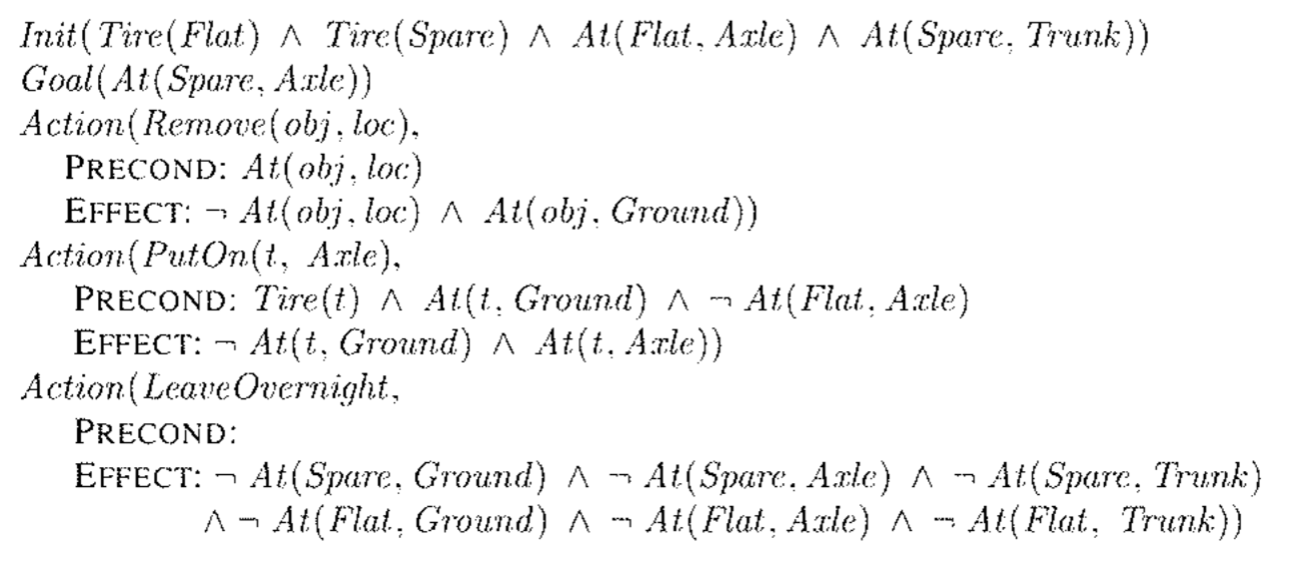
Example: Spare Tire Problem
The negated precondition ¬At(Flat,Axle) not allowed in STRIPS
Could be easily replaced with Clear(Axle), adding one more predicate to the language

Slide 22
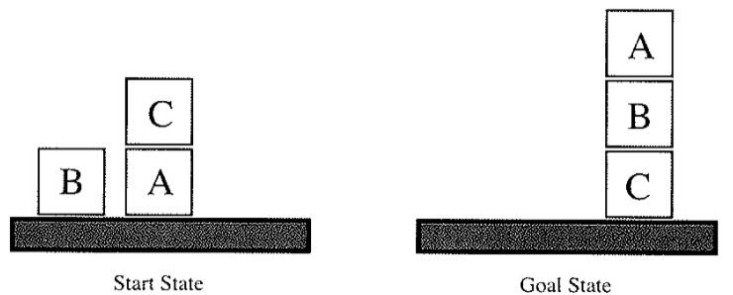
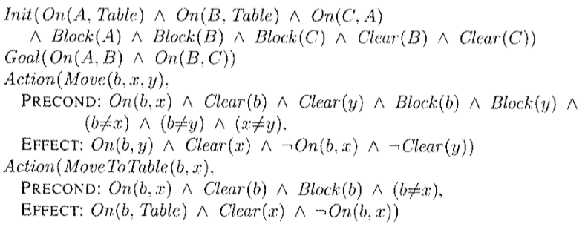
Example: Blocks World
Initial state; Goal state; Actions: Move(b,x,y), MoveToTable(b,x)

Slide 23
Outline
Background
  Situation Calculus
  Frame, qualification, & ramification problems
Representation language
Planning Algorithms
  State-Space Search
  Partial-Order Planning (POP)
  Planning Graphs (GraphPlan)
  SAT Planners

Slide 24
State-Space Search (1)
Search the space of states (first chapters)
  Initial state, goal test, step cost, etc.
  Actions are the transitions between state
Actions are invertible (why?)
  Move forward from the initial state: Forward State-Space Search or Progression Planning
  Move backward from goal state: Backward State-Space Search or Regression Planning

Slide 25
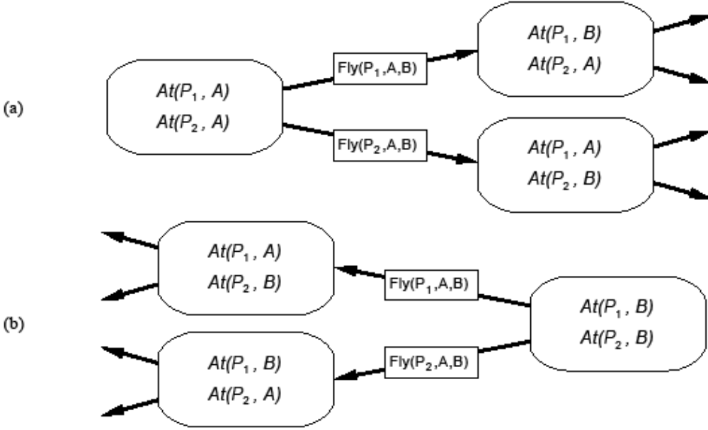
State-Space Search (2)

Slide 26
State-Space Search (3)
Remember that the language has no functions symbols
Thus number of states is finite
And we can use any complete search algorithm (e.g., A*)
  We need an admissible heuristic
  The solution is a path, a sequence of actions: total-order planning
Problem: Space and time complexity
  STRIPS-style planning is PSPACE-complete unless actions have
    only positive preconditions and
    only one literal effect

Slide 27
SRIPS in State-Space Search
STRIPS representation makes it easy to focus on ‘relevant’ propositions and
  Work backward from goal (using EFFECTS)
  Work forward from initial state (using PRECONDITIONS)
  Facilitating bidirectional search

Slide 28
Relevant Action
An action is relevant
  In Progression planning when its preconditions match a subset of the current state
  In Regression planning, when its effects match a subset of the current goal state

Slide 29
Consistent Action
The purpose of applying an action is to ‘achieves a desired literal’
We should be careful that the action does not undo a desired literal (as a side effect)
A consistent action is an action that does not undo a desired literal

Slide 30
Backward State-Space Search
Given
  A goal G description
  An action A that is relevant and consistent
Generate a predecessor state where
  Positive effects (literals) of A in G are deleted
  Precondition literals of A are added unless they already appear
  Substituting any variables in A’s effects to match literals in G
  Substituting any variables in A’s preconditions to match substitutions in A’s effects
Repeat until predecessor description matches initial state

Slide 31
Heuristic to Speed up Search
We can use A*, but we need an admissible heuristic
  Divide-and-conquer: sub-goal independence assumption
  Problem relaxation by removing
  … all preconditions
  … all preconditions and negative effects
  … negative effects only: Empty-Delete-List

Slide 32
1. Subgoal Independence Assumption
The cost of solving a conjunction of subgoals is the sum of the costs of solving each subgoal independently
Optimistic
  Where subplans interact negatively
  Example: one action in a subplan delete goal achieved by an action in another subplan
Pessimistic (not admissible)
  Redundant actions in subplans can be replaced by a single action in merged plan

Slide 33
2. Problem Relaxation: Removing Preconditions
Remove preconditions from action descriptions
  All actions are applicable
  Every literal in the goal is achievable in one step
Number of steps to achieve the conjunction of literals in the goal is equal to the number of unsatisfied literals
Alert
  Some actions may achieve several literals
  Some action may remove the effect of another action

Slide 34
3. Remove Preconditions & Negative Effects
Considers only positive interactions among actions to achieve multiple subgoals
The minimum number of actions required is the sum of the union of the actions’ positive effects that satisfy the goal
The problem is reduced to a set cover problem, which is NP-hard
  Approximation by a greedy algorithm cannot guarantee an admissible heuristic

Slide 35
4. Removing Negative Effects (Only)
Remove all negative effects of actions (no action may destroy the effects of another)
Known as the Empty-Delete-List heuristic
Requires running a simple planning algorithm
Quick & effective
Usable in progression or regression planning

Slide 36
Outline
Background
  Situation Calculus
  Frame, qualification, & ramification problems
Representation language
Planning Algorithms
  State-Space Search
  Partial-Order Planning (POP)
  Planning Graphs (GraphPlan)
  SAT Planners

Slide 37
Partial Order Planning (POP)
State-space search
  Yields totally ordered plans (linear plans)
POP
  Works on subproblems independently, then combines subplans
  Example
    Goal(RightShoeOn ∧ LeftShoeOn)
    Init()
    Action(RightShoe, PRECOND: RightSockOn, EFFECT: RightShoeOn)
    Action(RightSock, EFFECT: RightSockOn)
    Action(LeftShoe, PRECOND: LeftSockOn, EFFECT: LeftShoeOn)
    Action(LeftSock, EFFECT: LeftSockOn)

Slide 38
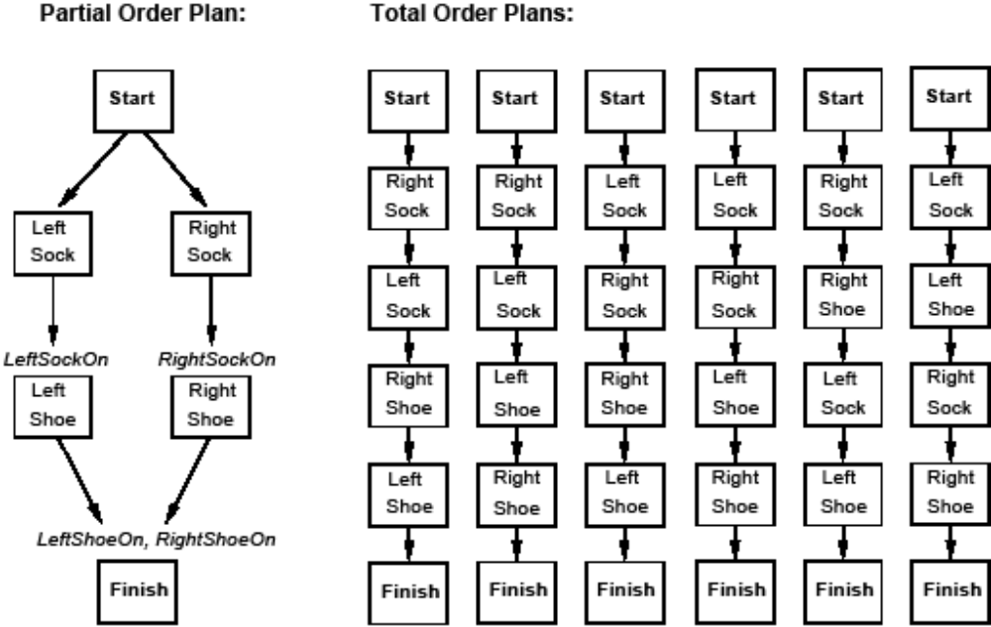
POP Example & its linearization

Slide 39
Components of a Plan
A set of actions
A set of ordering constraints
  A p B reads “A before B” but not necessarily immediately before B
  Alert: caution to cycles A p B and B p A
A set of causal links (protection intervals) between actions
  A B reads “A achieves p for B” and p must remain true from the time A is applied to the time B is applied
  Example “RightSock RightShoe
A set of open preconditions
  Planners work to reduce the set of open preconditions to the empty set w/o introducing contradictions
p
RightSockOn

Slide 40
Consistent Plan (POP)
Consistent plan is a plan that has
  No cycle in the ordering constraints
  No conflicts with the causal links
Solution
  Is a consistent plan with no open preconditions
To solve a conflict between a causal link A B and an action C (that clobbers, threatens the causal link), we force C to occur outside the “protection interval” by adding
  the constraint C p A (demoting C) or
  the constraint B p C (promoting C)
p

Slide 41
Setting up the PoP
Start
Add dummy states
  Start
    Has no preconditions
    Its effects are the literals of the initial state
  Finish
    Its preconditions are the literals of the goal state
    Has no effects
Initial Plan:
  Actions: {Start, Finish}
  Ordering constraints: {Start p Finish}
  Causal links: {}
  Open Preconditions: {LeftShoeOn,RightShoeOn}
Literal_{a}, Literal_{b}, …
Literal₁, Literal₂, …
Finish
Start
LeftShoeOn, RightShoeOn
Finish

Slide 42
POP as a Search Problem
The successor function arbitrarily picks one open precondition p on an action B
For every possible consistent action A that achieves p
  It generates a successor plan adding the causal link A B and the ordering constraint A p B
  If A was not in the plan, it adds Start p A and A p Finish
  It resolves all conflicts between
    the new causal link and all existing actions
    between A and all existing causal links
  Then it adds the successor states for combination of resolved conflicts
It repeats until no open precondition exists
p

Slide 43
Example of POP: Flat tire problem
See problem description in Fig 10.13 page 391
Only one open precondition
Only 1 applicable action
Start
At(Spare,Trunk), At(Flat,Axle)
At(Spare,Ground), ¬At(Flat,Axle)
PutOn(Spare,Axle)
Pick up At(Spare,Ground)
Choose only applicable action Remove(Spare,Trunk)
At(Spare,Axle)
Finish

Slide 44
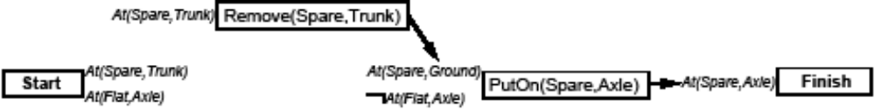
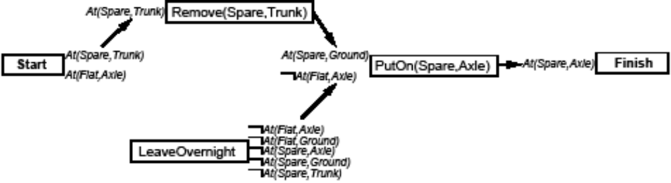
Add causal link between Remove(Spare,Trunk) and PutOn(Spare,Axle)
Pick up ¬At(Flat,Axle)
There are 2 applicable actions: LeaveOvernight and Remove(Flat,Axle)
Choose LeaveOvernight
LeaveOvernight has effect ¬At(Spare,Ground), which conflicts with the causal link
We remove the conflict by forcing LeaveOvernight to occur before Remove(Spare,Trunk)
Conflicts with effects of Remove(Spare,Trunk)
The only way to resolve the conflict is to undo LeaveOvernightuse the action Remove(Flat,Axle)

Slide 45
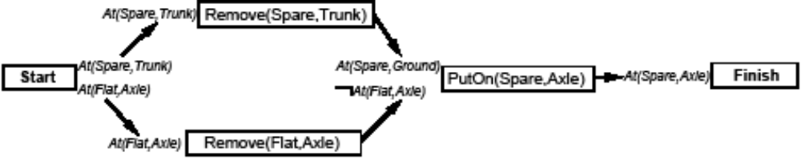
This time, we choose Remove(Flat,Axle)
Pick up At(Spare,Trunk) and choose Start to achieve it
Pick up At(Flat,Axle) and choose Start to achieve it.
We now have a complete consistent partially ordered plan

Slide 46
POP Algorithm (1)
Backtrack when fails to resolve a threat or find an operator
Causal links
  Recognize when to abandon a doomed plan without wasting time expanding irrelevant part of the plan
  allow early pruning of inconsistent combination of actions
When actions include variables, we need to find appropriate substitutions
  Typically we try to delay commitments to instantiating a variable until we have no other choice (least commitment)
POP is sound, complete, and systematic (no repetition)

Slide 47
POP Algorithm (2)
Decomposes the problem (advantage)
But does not represent states explicitly: it is hard to design heuristic to estimate distance from goal
  Example: Number of open preconditions – those that match the effects of the start node. Not perfect (same problems as before)
A heuristic can be used to choose which plan to refine (which precondition to pick-up):
  Choose the most-constrained precondition, the one satisfied by the least number of actions. Like in CSPs!
  When no action satisfies a precondition, backtrack!
  When only one action satisfies a precondition, pick up the precondiction.

Slide 48
Outline
Background
  Situation Calculus
  Frame, qualification, & ramification problems
Representation language
Planning Algorithms
  State-Space Search
  Partial-Order Planning (POP)
  Planning Graphs (GraphPlan)
  SAT Planners

Slide 49
Planning Graph
Is special data structure used for
  Deriving better heuristic estimates
  Extract a solution to the planning problem: GRAPHPLAN algorithm
Is a sequence ⟨S₀,A₀,S₁,A₁,…,S_{i}⟩ of levels
  Alternating state levels & action levels
  Levels correspond to time stamps
  Starting at initial state
  State level is a set of (propositional) literals
    All those literals that could be true at that level
  Action level is a set of (propositionalized) actions
    All those actions whose preconditions appear in the state level (ignoring all negative interactions, etc.)
Propositionalization may yield combinatorial explosition in the presence of a large number of objects

Slide 50
Focus
Building the Planning Graph
Using it for Heuristic Estimation
Using it for generating the plan

Slide 51
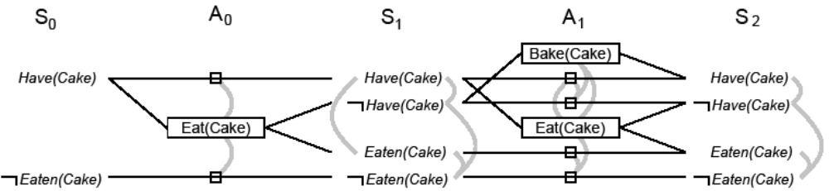
Example of a Planning Graph (1)
Init(Have(Cake))
Goal(Have(Cake)∧Eaten(Cake))
Action(Eat(Cake)
  Precond: Have(Cake)
  Effect: ¬Have(Cake)∧Eaten(Cake))
  Action(Bake(Cake)
  Precond: ¬Have(Cake)
  Effect: Have(Cake))
Propositions true at the initial state
Persistence Actions (noop)
Action is connected to its preconds & effects

Slide 52
Example of a Planning Graph (2)
At each state level, list all literals that may hold at that level
At each action level, list all noops & all actions whose preconditions may hold at previous levels
Repeat until plan ‘levels off,’ no new literals appears (S_{i}=S_{i+1})
Building the Planning Graph is a polynomial process
Add (binary) mutual exclusion (mutex) links between conflicting actions and between conflicting literals
Mutual exclusion links
S₁ represents multiple states

Slide 53
Mutex Links between Actions
Inconsistent effects: one action negates an effect of another
  Eat(Cake) & noop of Have(Cake) disagree on effect Have(Cake)
Interference: An action effect negates the precondition of another
  Eat(Cake) negates precondition of the noop of Have(Cake):
Competing needs: A precondition on an action is mutex with the precondition of another
  Bake(Cake) & Eat(Cake): compete on Have(Cake) precondition

Slide 54
Mutex Links between Literals
Two literals are negation of each other
Inconsistent support: Each pair of actions that can achieve the two literals is mutex. Examples:
  In S1, Have(Cake) & Eaten(Cake) are mutex
  In S2, they are not because Bake(Cake) & the noop of Eaten(Cake) are not mutex

Slide 55
Focus
Building the Planning Graph
Using it for Heuristic Estimation
  Planning graph as a relaxation of original problem
  Easy to build (compute)
Using it for generating the plan

Slide 56
Planning Graph for Heuristic Estimation
A literal that does not appear in the final level cannot be achieved by any plan
  State-space search: Any state containing an unachievable literal has cost h(n)=∝
  POP: Any plan with an unachievable open condition has cost h(n)=∝
The estimate cost of any goal literal is the first level at which it appears
  Estimate is admissible for individual literals
  Estimate can be improved by serializing the graph (serial planning graph: one action per level) by adding mutex between all actions in a given level
The estimate of a conjunction of goal literals
  Three heuristics: max level, level sum, set level

Slide 57
Estimate of Conjunction of Goal Literals
Max-level
  The largest level of a literal in the conjunction
  Admissible, not very accurate
Level sum
  Under subgoal independence assumption, sums the level costs of the literals
  Inadmissible, works well for largely decomposable problems
Set level
  Finds the level at which all literals appear w/o any pair of them being mutex
  Dominates max-level, works extremely well on problems where there is a great deal of interaction among subplans

Slide 58
Focus
Building the Planning Graph
Using it for Heuristic Estimation
Using it for generating the plan
  GraphPlan algorithm [Blum & Furst, 95]

Slide 59
GRAPHPLAN algorithm
GRAPHPLAN(problem) returns solution or failure
graph ← INITIALPLANNINGGRAPH(problem)
goals ← GOALS[problem]
loop do
if goals all non-mutex in last level of graph then do
solution ← EXTRACTSOLUTION(graph,goals,LENGTH(graph))
if solution ≠ failure then return solution
else if NOSOLUTIONPOSSIBLE(graph) then return failure
graph ← EXPANDGRAPH (graph,problem)
Two main stages
  Extract solution
  Expand the graph

Slide 60
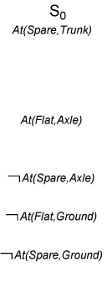
Example of GRAPHPLAN Execution (1)
At(Spare,Axle) is not in S₀
No need to extract solution
Expand the plan

Slide 61
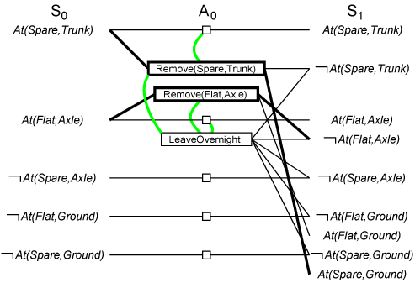
Example of GRAPHPLAN Execution (2)
Three actions are applicable
3 actions and 5 noops are added
Mutex links are added
At(Spare,Axle) still not in S₁
Plan is expanded

Slide 62
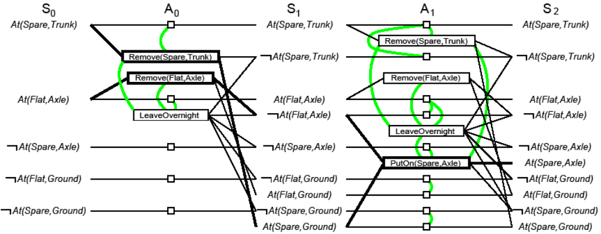
Example of GRAPHPLAN Execution (3)
Illustrates well mutex links: inconsistent effects, interference, competing needs, inconsistent support

Slide 63
Solution Extraction (Backward)
Solve a Boolean CSP: Variables are actions, domains are {0=out of plan, 1=in plan), constraints are mutex
Search problem from last level backward

Slide 64
Backtrack Search for Solution Extraction
Starting at the highest fact level
  Each goal is put in a goal list for the current fact layer
  Search iterates thru each fact in the goal list trying to find an action to support it which is not mutex with any other chosen action
  When an action is chosen, its preconditions are added to the goal list of the lower level
  When all facts in the goal list of the current level have a consistent assignment of actions, the search moves to the next level
Search backtracks to the previous level when it fails to assign an action to each fact in the goal list at a given level
Search succeeds when the first level is reached.

Slide 65
Termination of GRAPHPLAN
GRAPHPLAN is guaranteed to terminate
  Literal increase monotonically
  Actions increase monotonically
  Mutexes decrease monotinically
A solution is guaranteed not to exist when
  The graph levels off with all goals present & non-mutex, and
  EXTRACTSOLUTION fails to find solution

Slide 66
Optimality of GRAPHPLAN
The plans generated by GRAPHPLAN
  Are optimal in the number of steps needed to execute the plan
  Not necessarily optimal in the number of actions in the plan (GRAPHPLAN produces partially ordered plans)

Slide 67
Outline
Background
  Situation Calculus
  Frame, qualification, & ramification problems
Representation language
Planning Algorithms
  State-Space Search
  Partial-Order Planning (POP)
  Planning Graphs (GraphPlan)
  SAT Planners

Slide 68
October 20, 2005
Ordering heuristics

Slide 69
October 20, 2005
Ordering heuristics

